Slide 1
Project PET CARE System

Slide 2
Member
Lâm Kha Thành Công
Nguyễn Vũ Tuấn Anh
Dương Đình Nguyên

Slide 3
Introduce
Background
Project scope
Application features
Usecase Diagram
Sample interface

Slide 4
1. Background
In this area, health is an important feature. Even for pets, their needs must be provided.
With this mobile app, user can:
+Add new member to pet family.
+View all available services with best discount for your pet.
+View popular store in the with its services and info.
+Book an apointment for your pet with awsome services.
+Cancel an appointment anytime

Slide 5
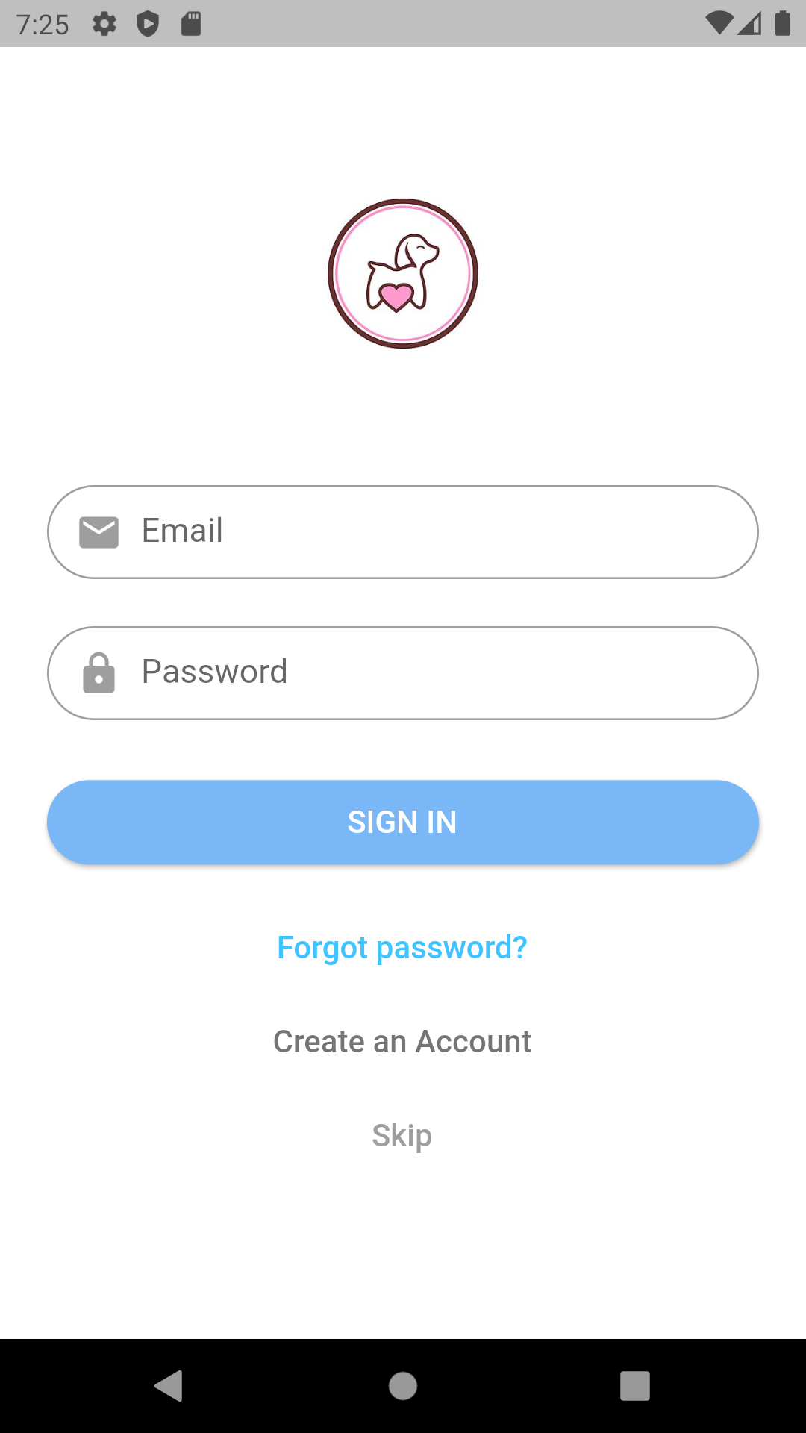
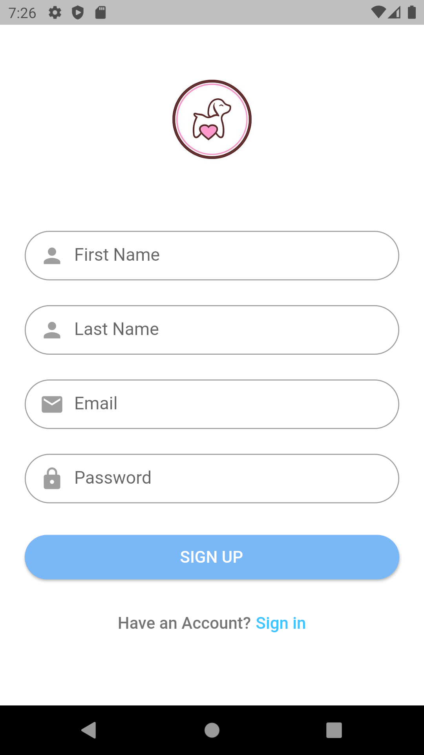
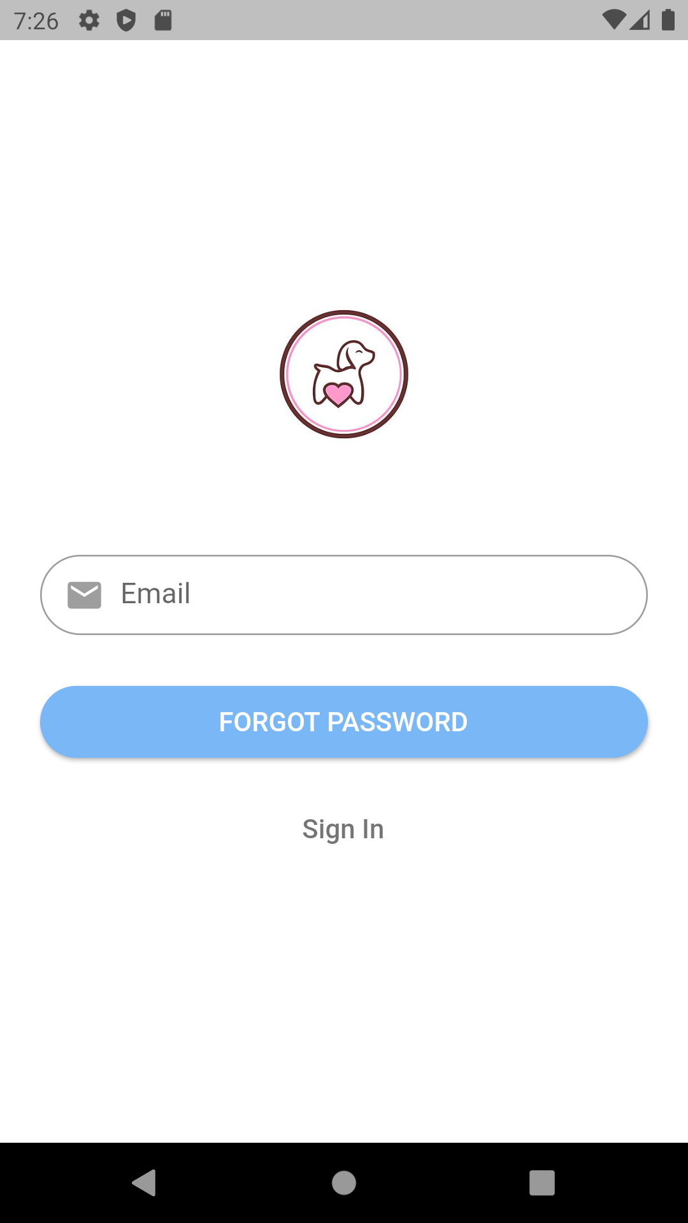
Login/Register/Forgot password

Slide 6
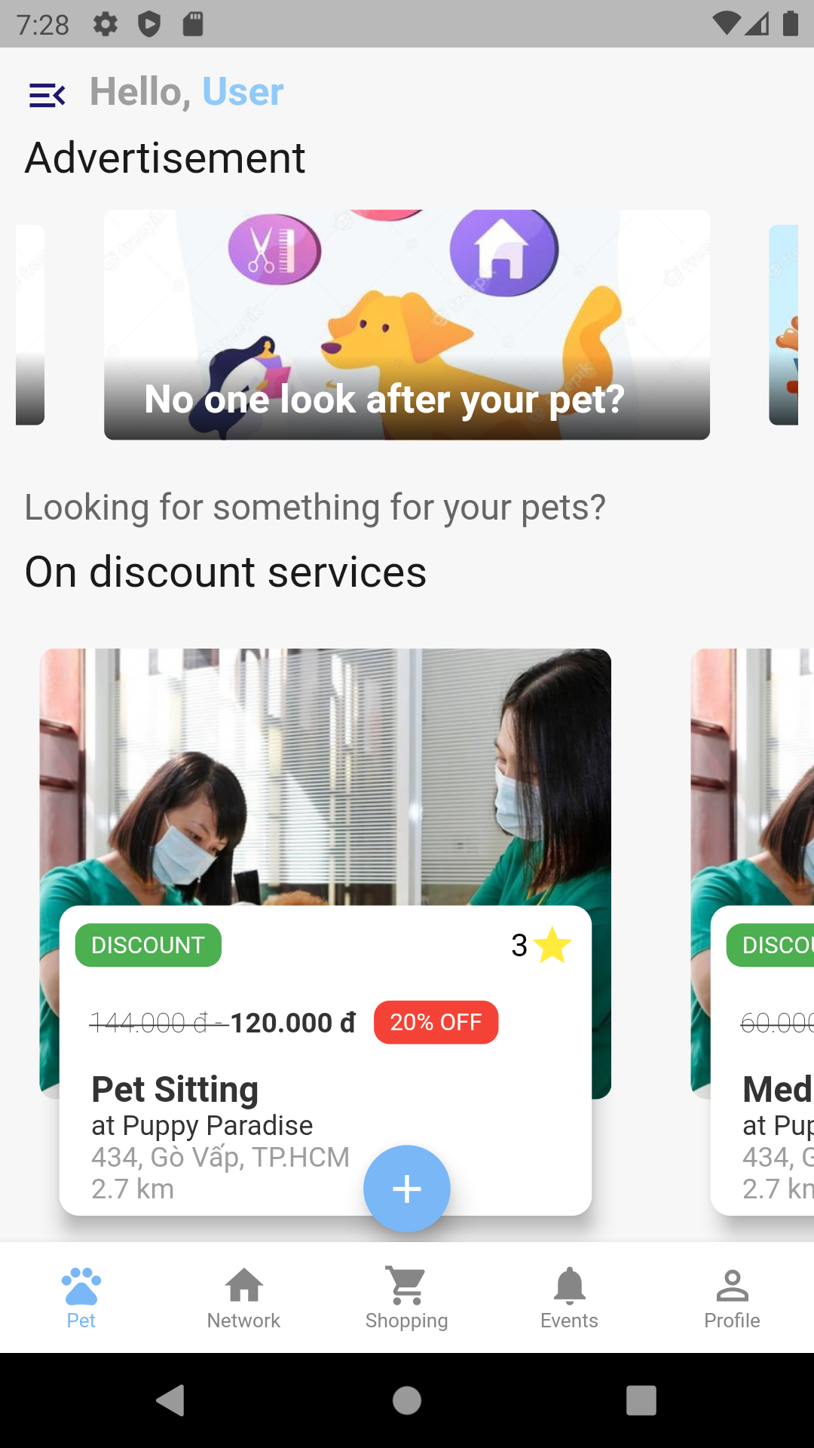
Main pet screen(1/2)

Slide 7
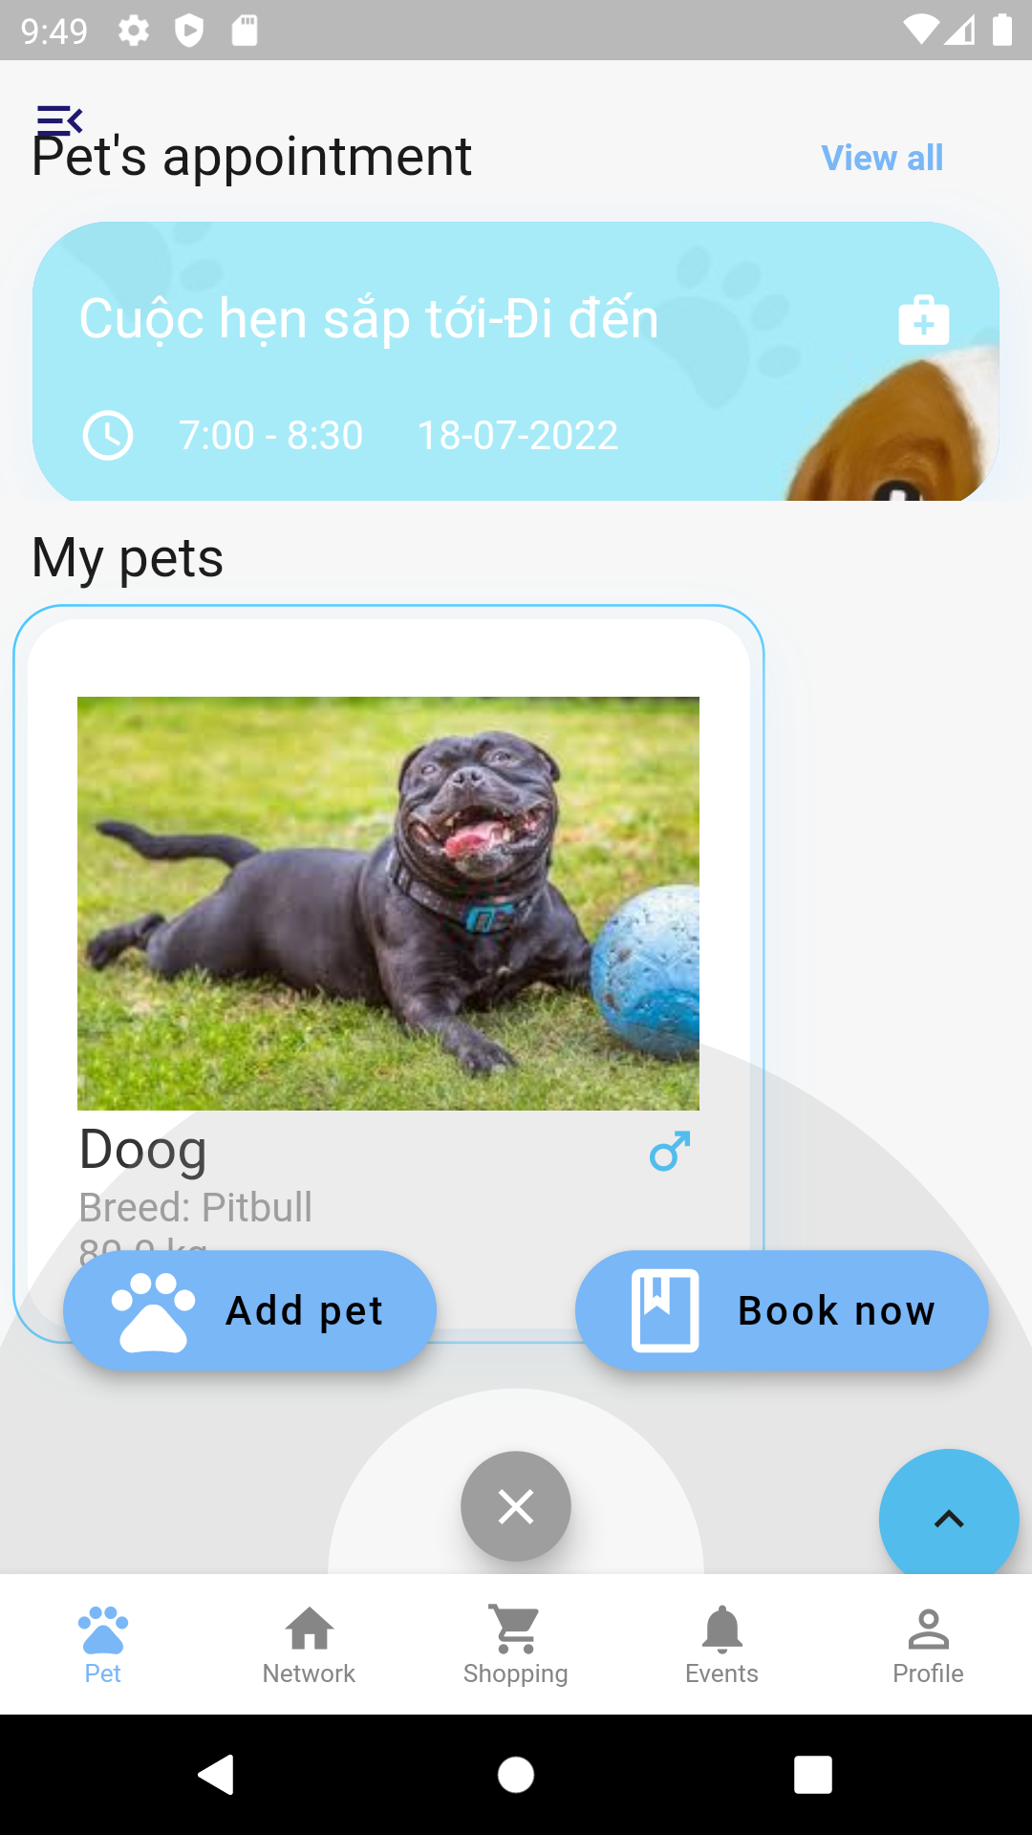
Main pet screen(2/2)

Slide 8
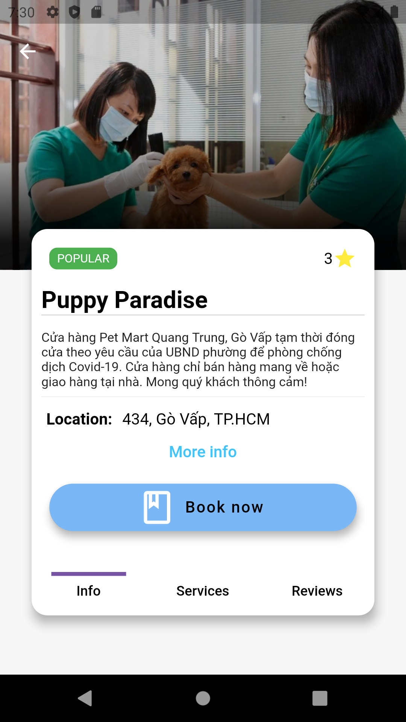
Store info screen(1/3)

Slide 9
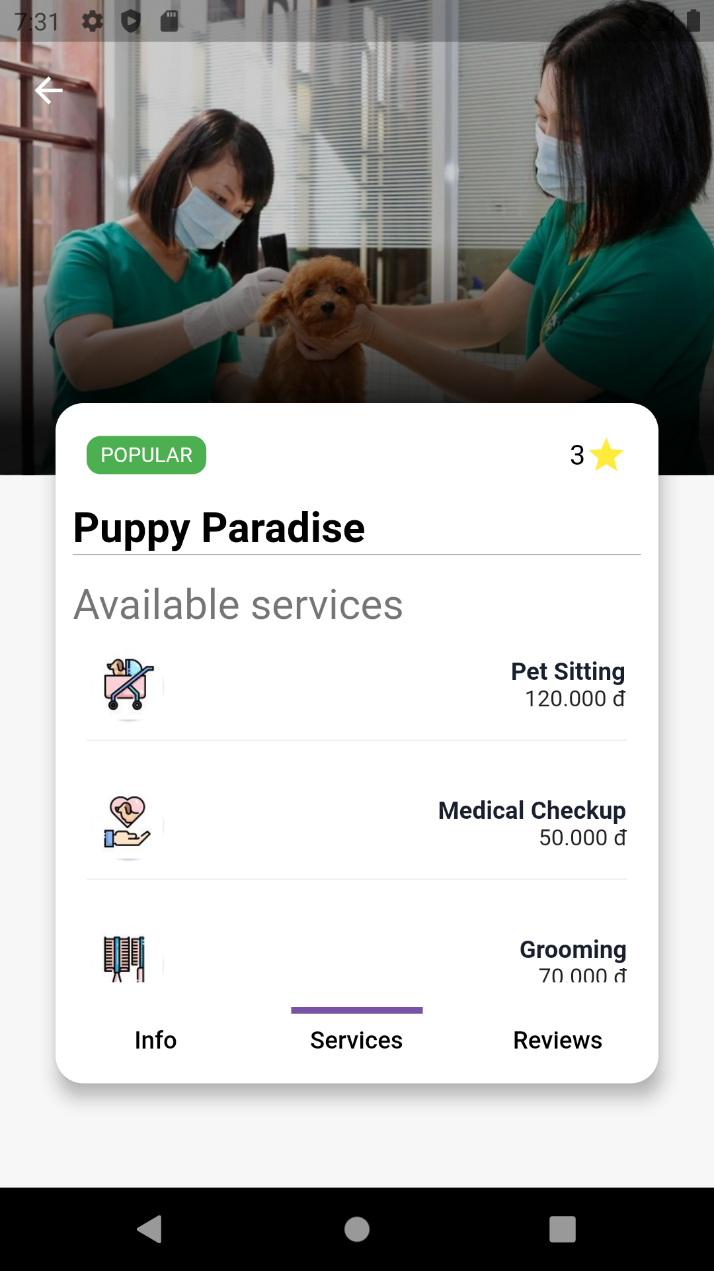
Store info screen(2/3)

Slide 10
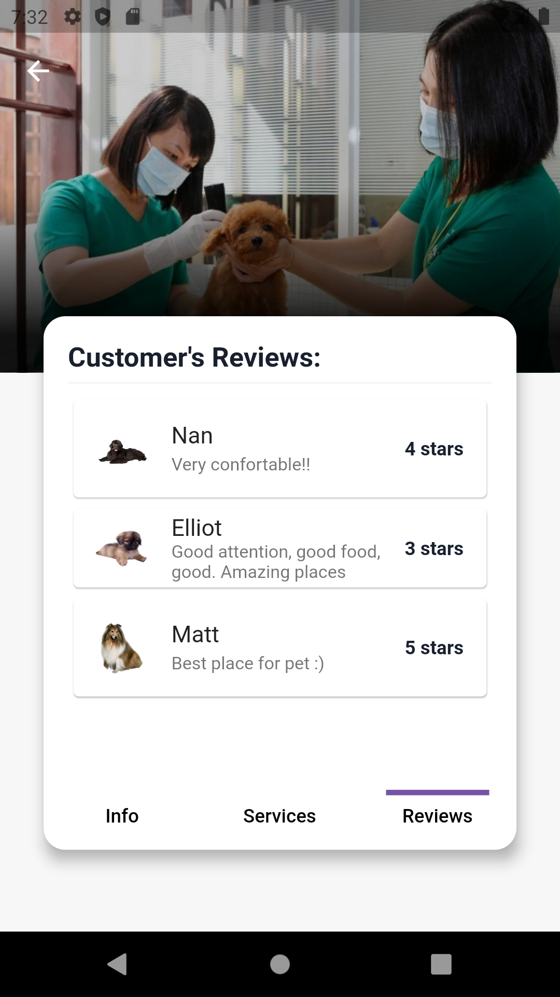
Store info screen (3/3)

Slide 11
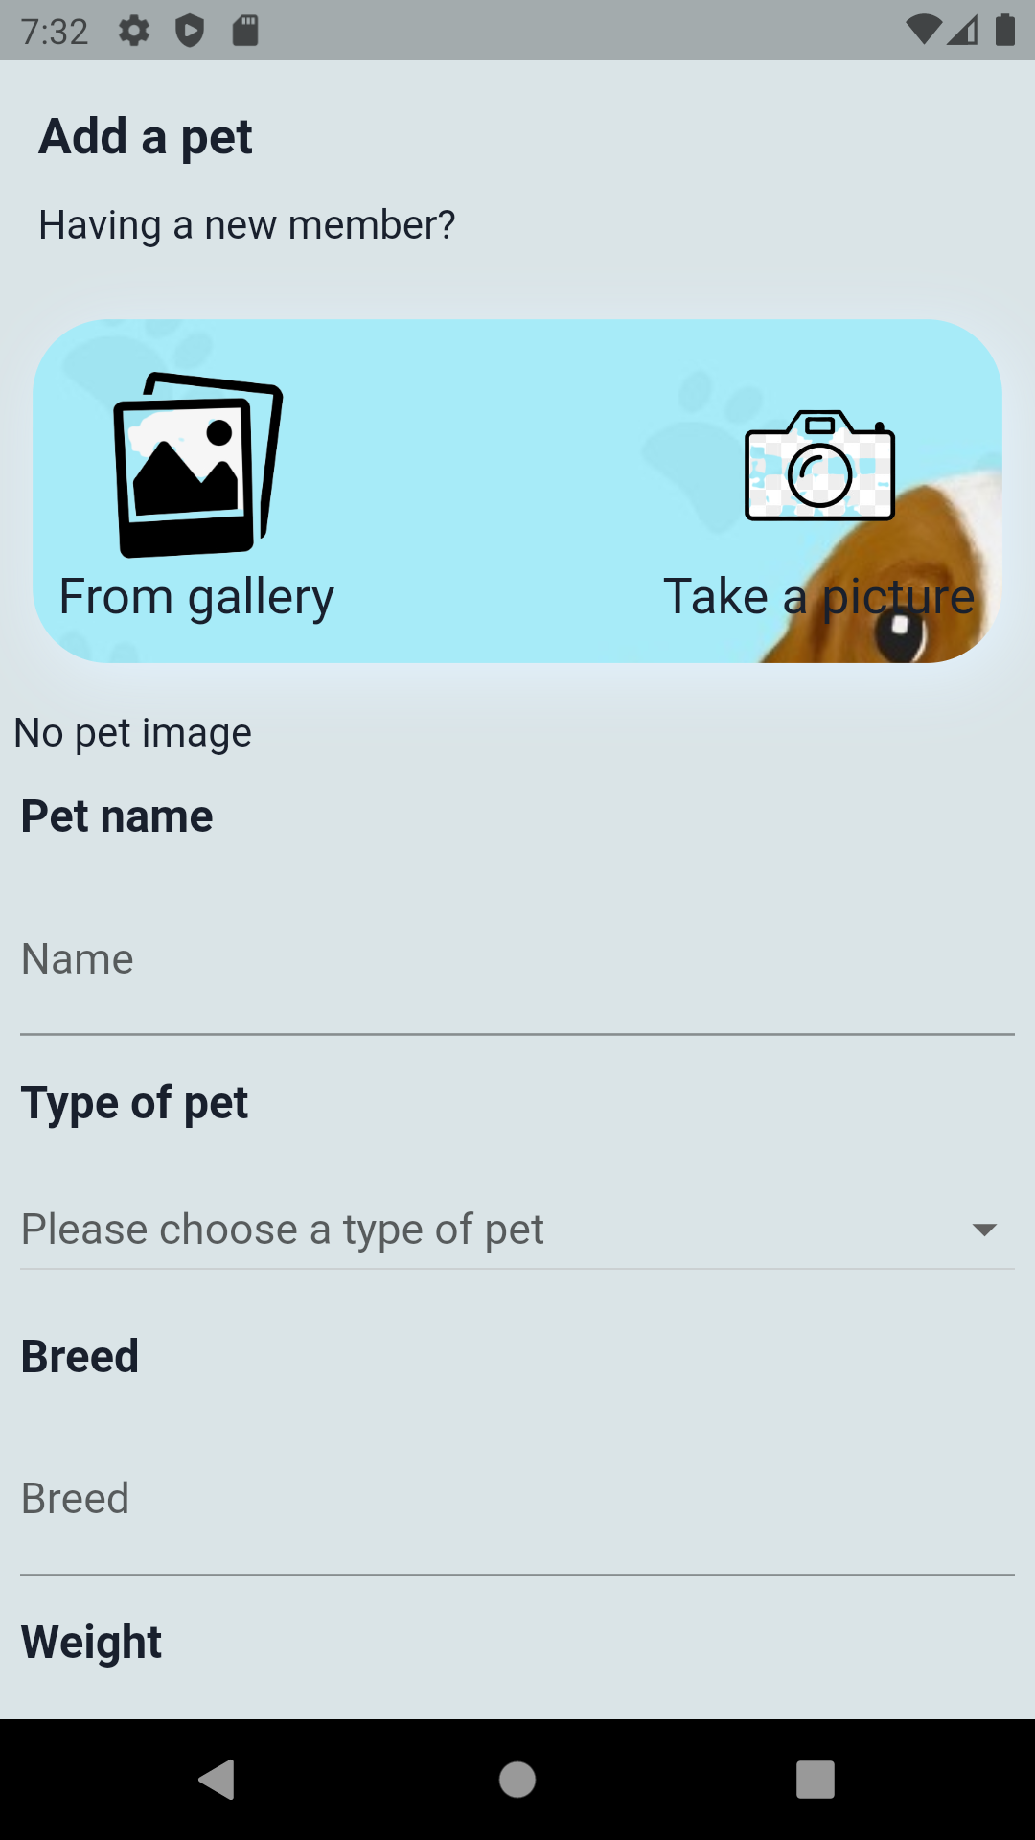
Add new pet

Slide 12
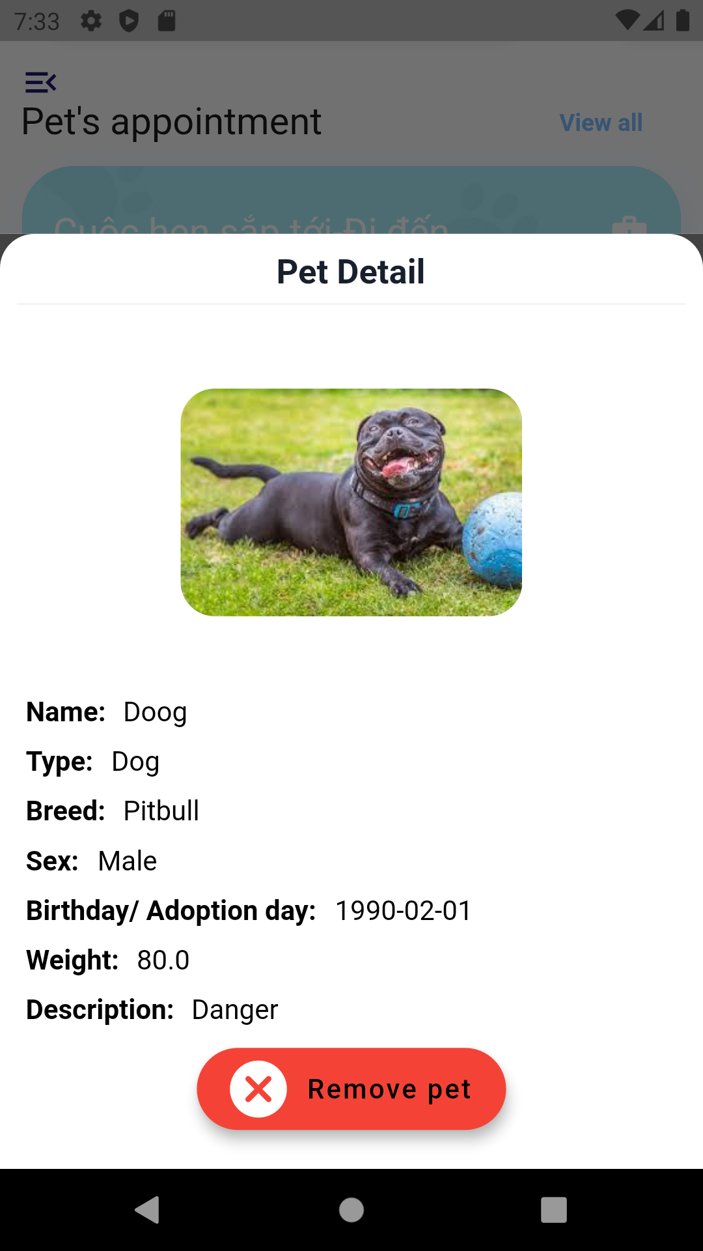
Pet info screen

Slide 13
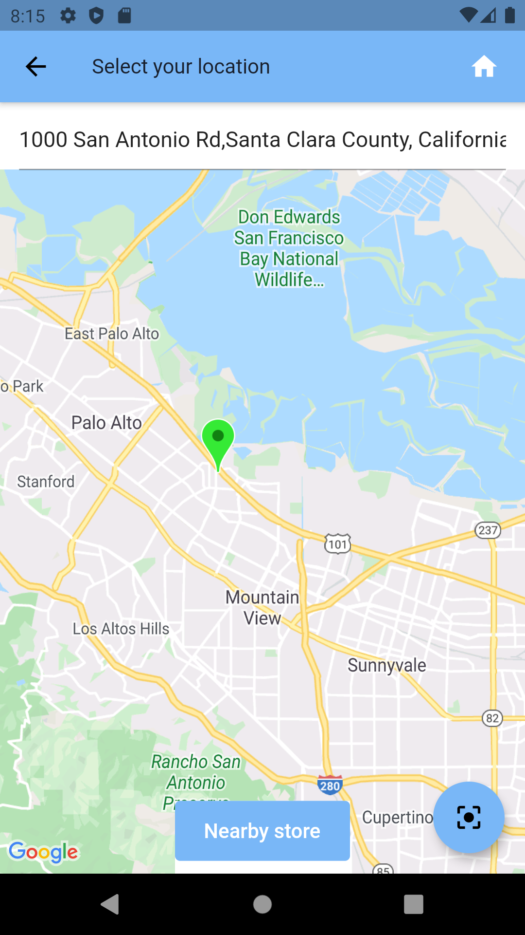
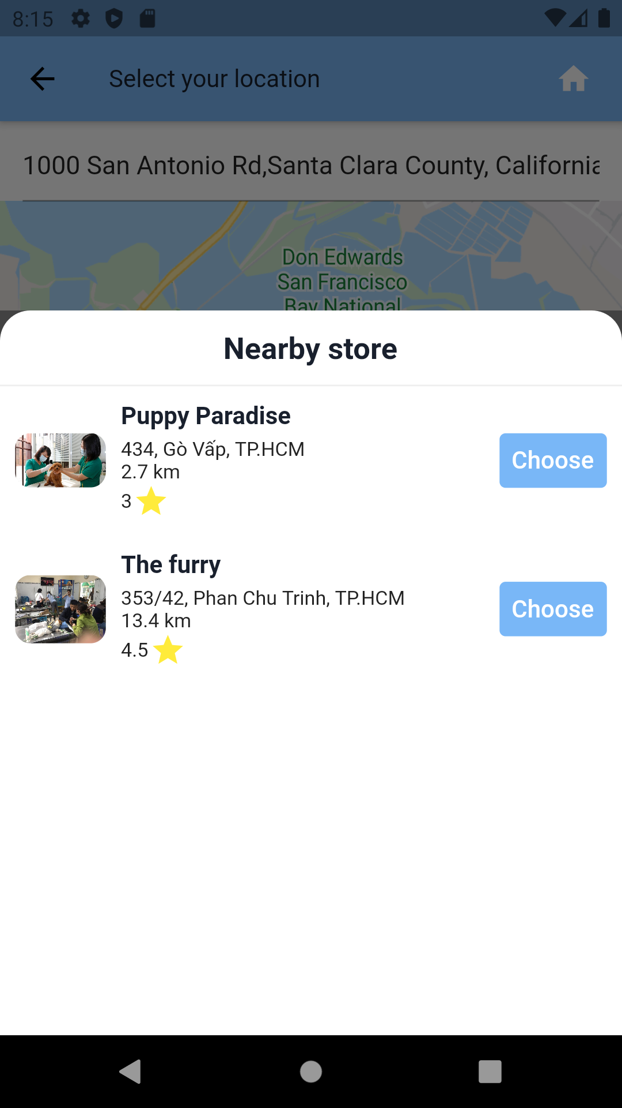
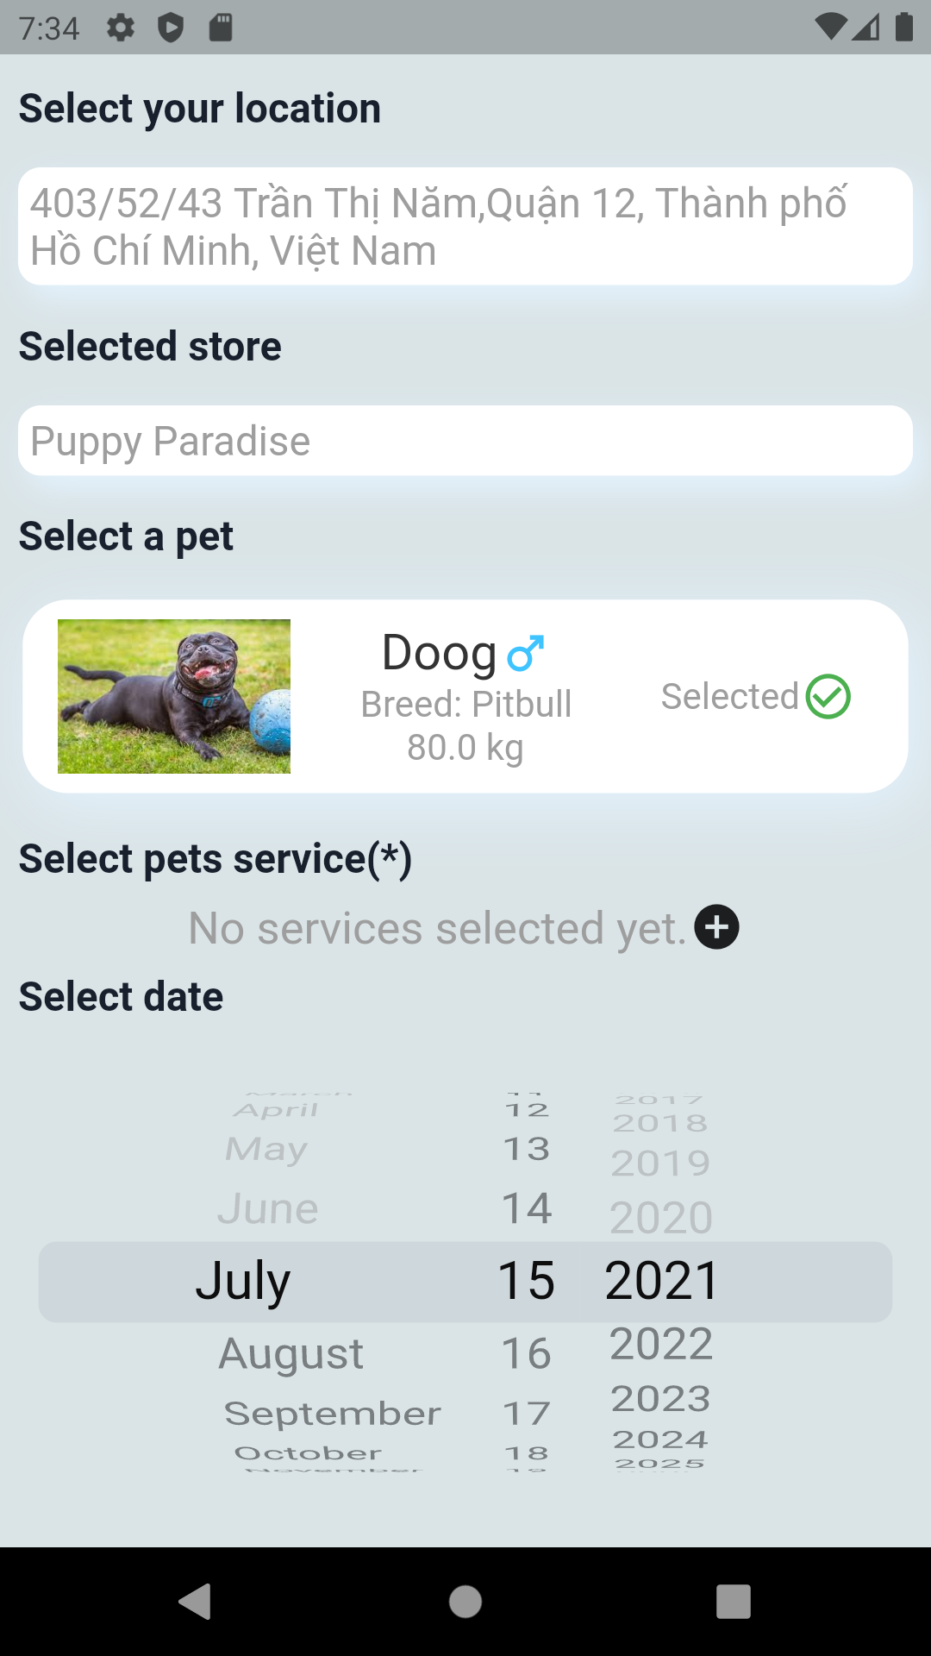
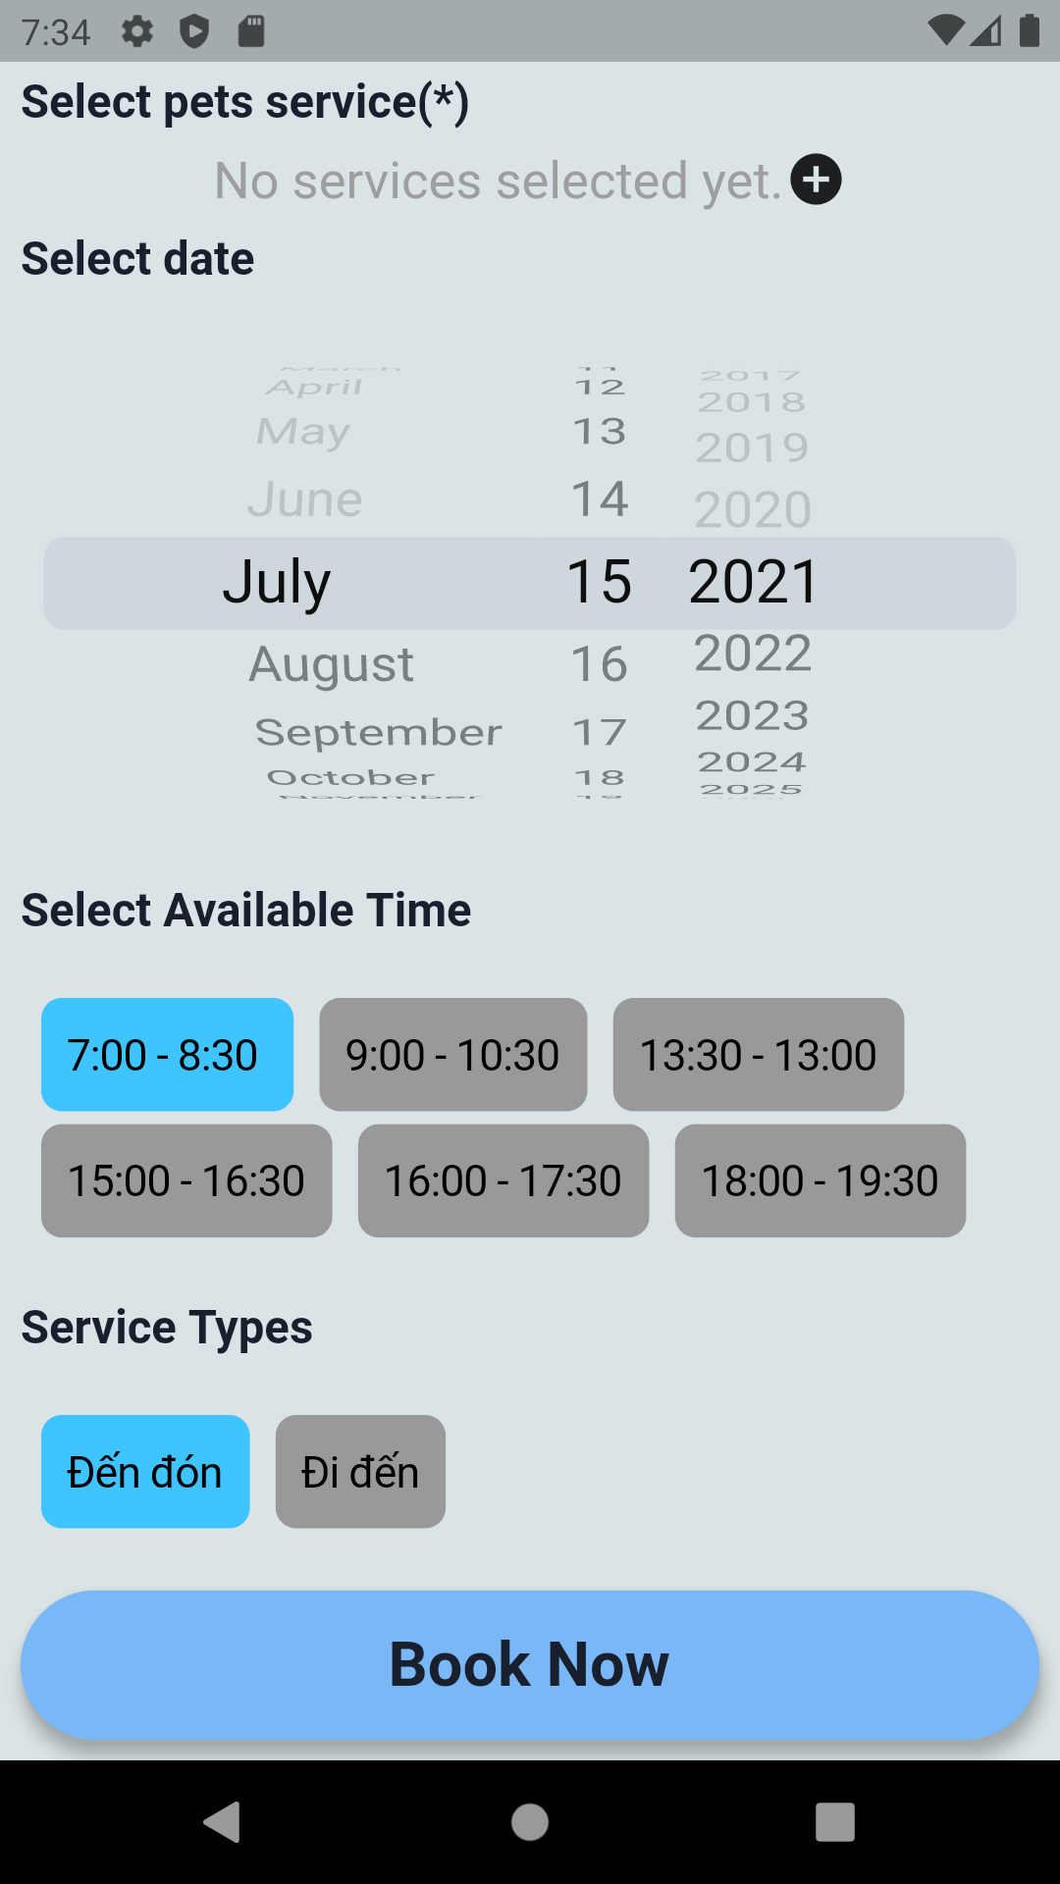
Booking services screen

Slide 14
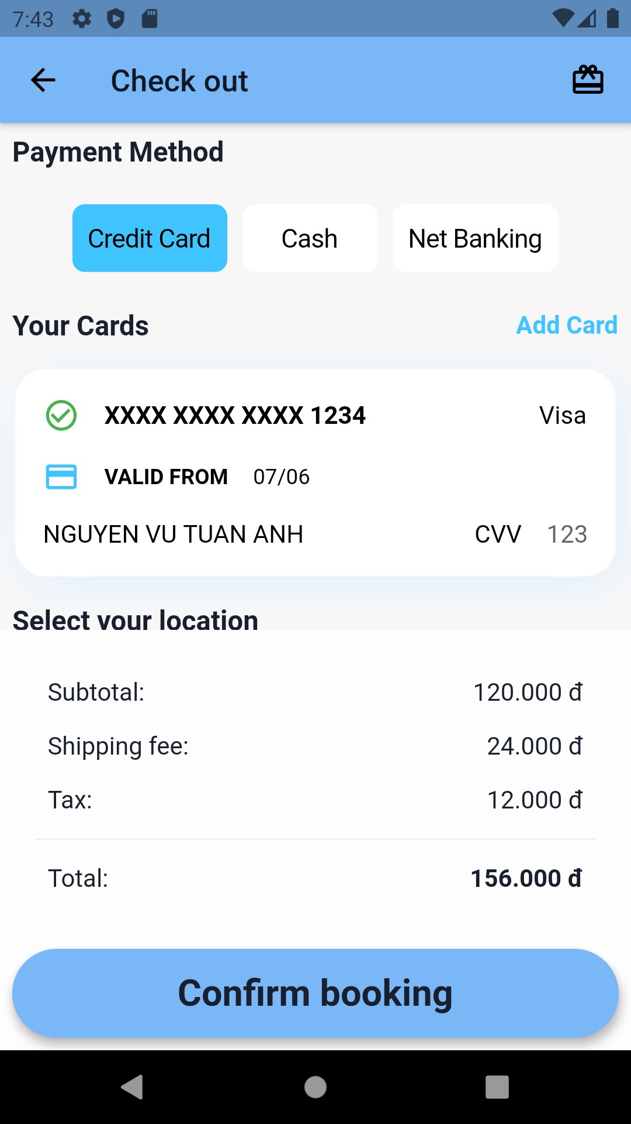
Check out screen

Slide 15
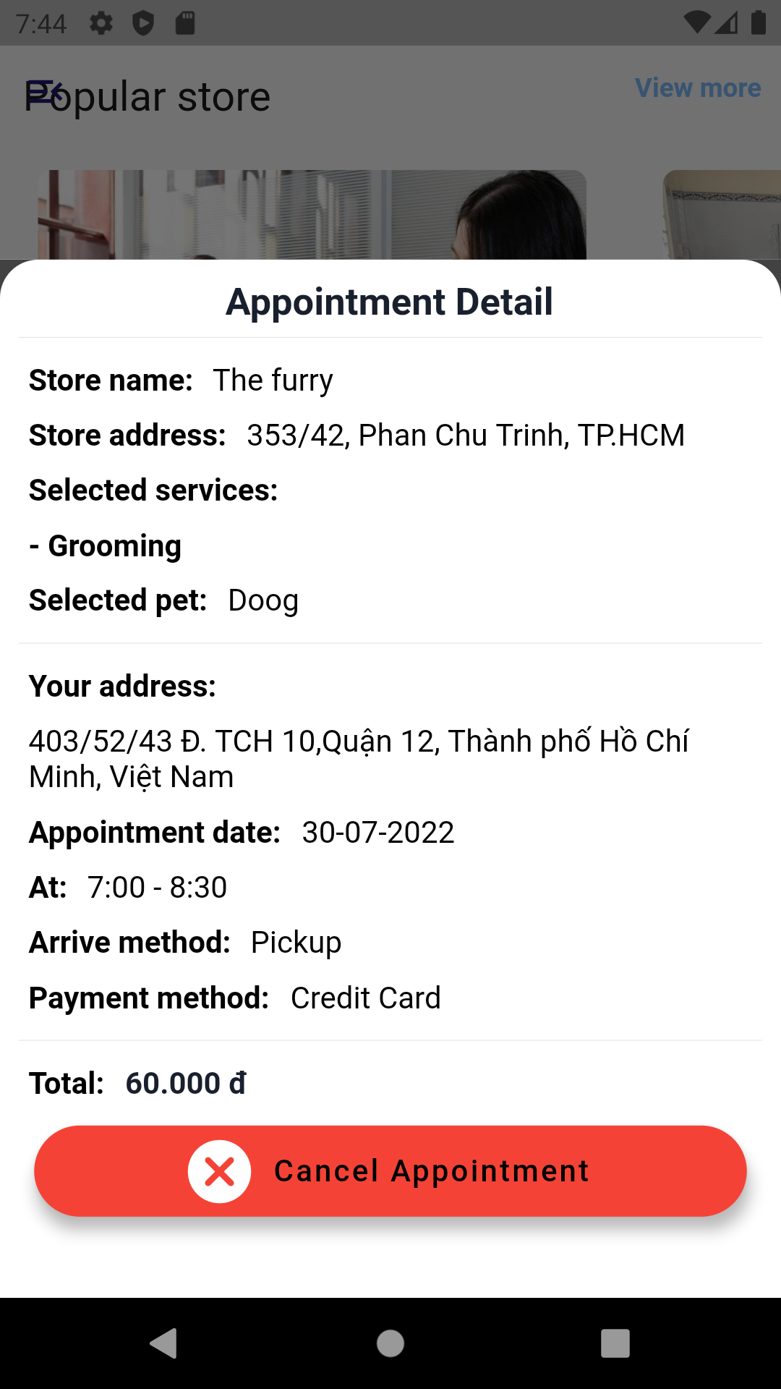
Appointment detail

Slide 16
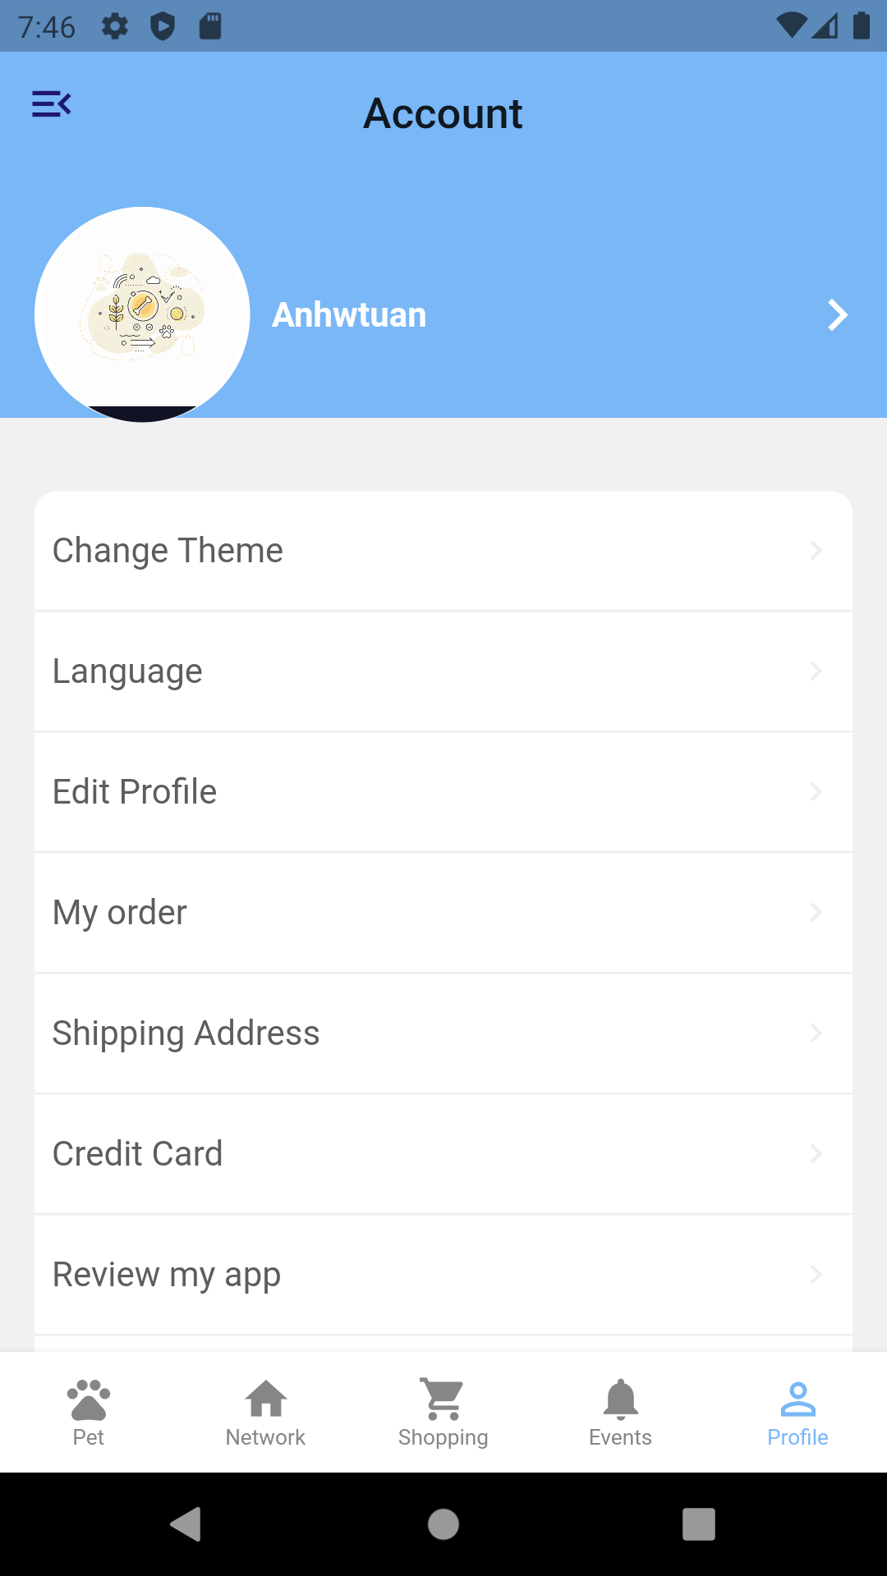
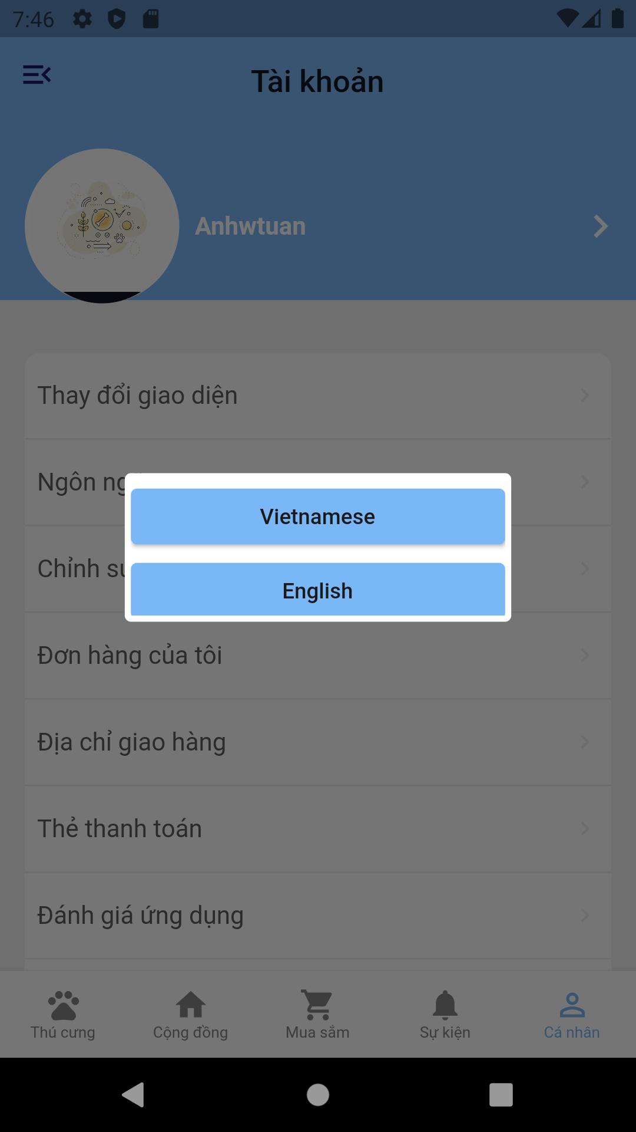
Profile screen

Slide 17
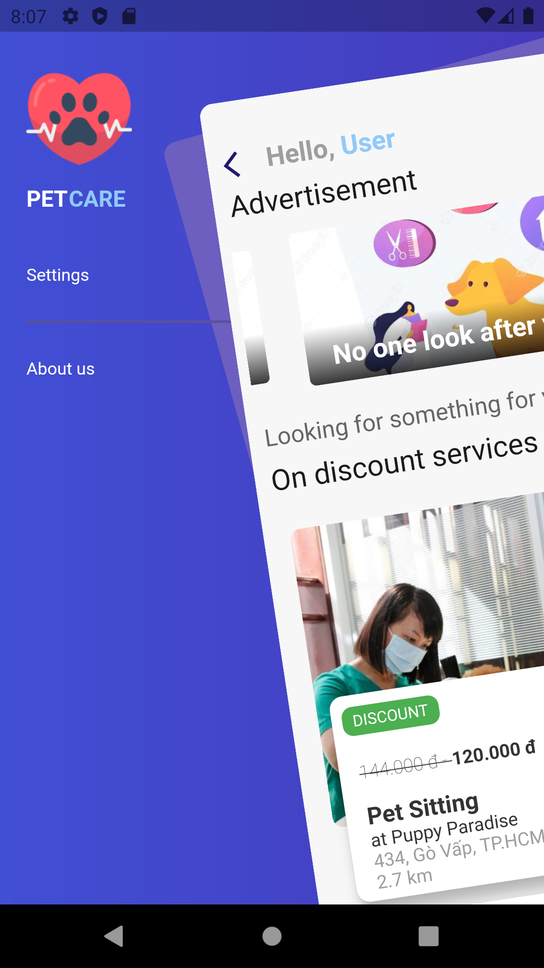
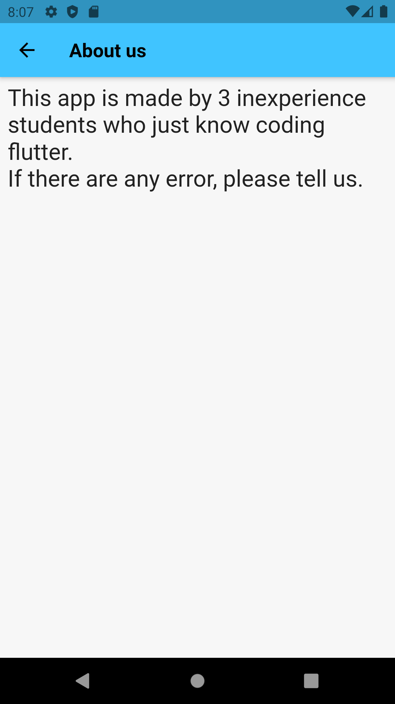
Addition screen (nothing special)

Slide 18
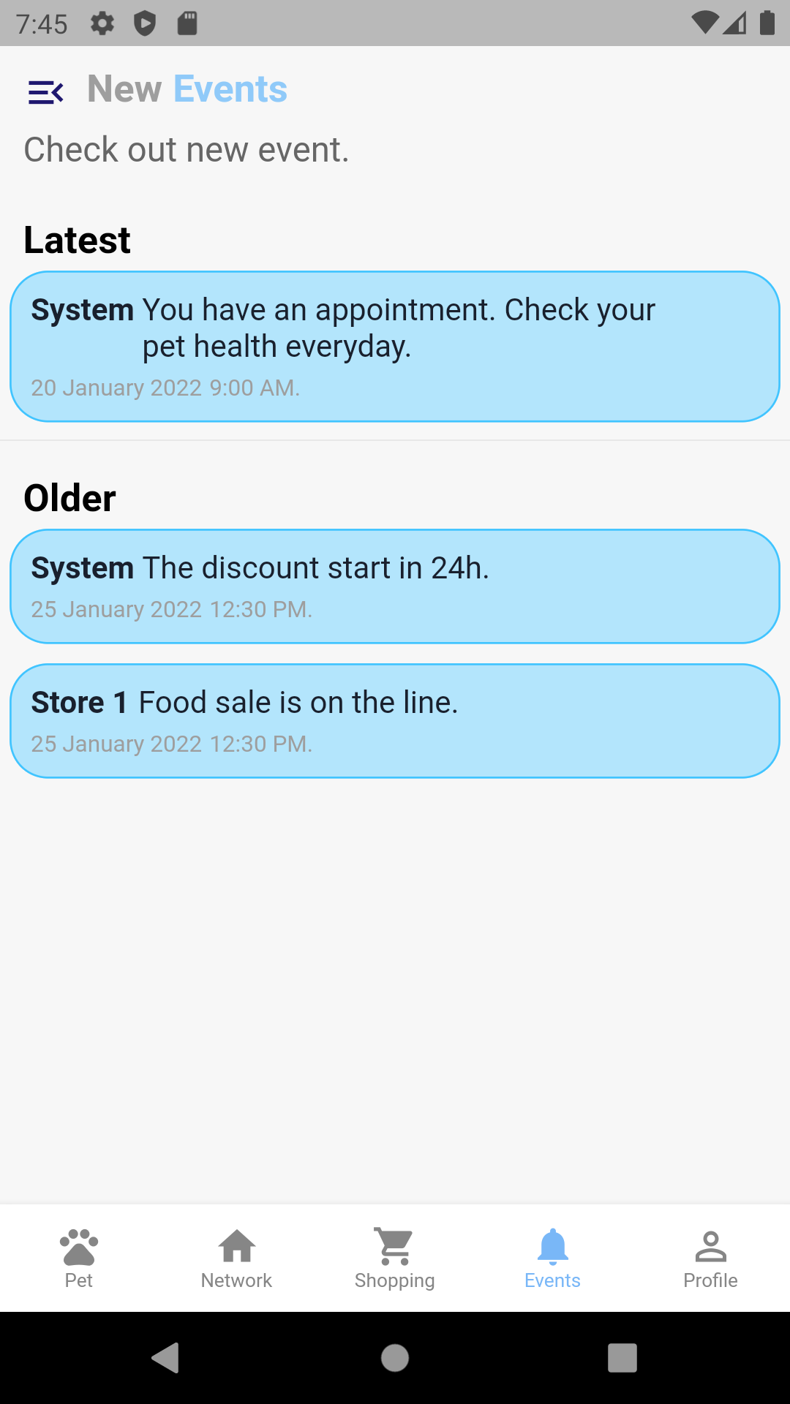
New events screen(Just UI)

Slide 19
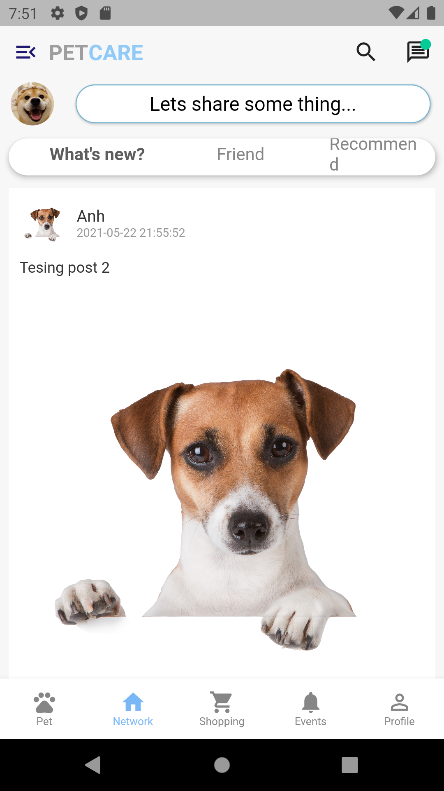
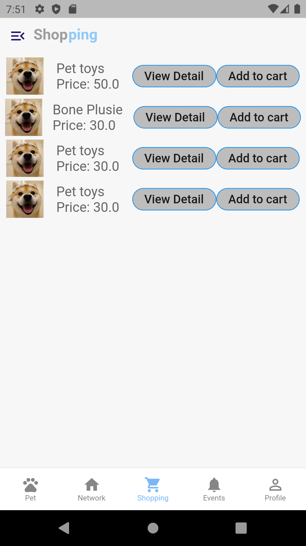
Addional UI screen(nothing functional)

